Slide 1
ANALYZING SENTIMENT IN MOVIE REVIEWS THROUGH NLP USING DEEP LEARNING FINAL PRESENTATION GANESH KRISHNA LAKSHMISETTY (1002086481)

Slide 2
AGENDA
INTRODUCTION
DATASET DESCRIPTION
PROJECT DESCRIPTION
MAIN REFERENCE USED
DIFFERENCE IN APPROACH
DIFFERENCE IN ACCURACY
IMPLEMENTATION
ANALYSIS
EVALUATION
REFERENCES

Slide 3
Introduction
Movie reviews have gained substantial traction in recent times.
Positive reviews Instil confidence, prompting viewers to engage with the movie. Conversely, negative reviews discourage audiences, preserving their precious time.
Hence, sentiment analysis for movie reviews plays a pivotal role. By categorizing each review as either positive or negative, it empowers audiences to select films with the highest positiveness, ensuring a more enjoyable viewing experience.

Slide 4
DATASET DESCRIPTION
Large movie review: http://ai.stanford.edu/~amaas/data/sentiment/
The total size of the dataset is 50,000 reviews.
It was split into 25,000 reviews for the train set, and 25,000 reviews for the test set.
Also, the train and test set have the same equal distribution of the sentiment. I.e 12500 positive, and 12500 negative.
Some constraints in dataset:
In these total 50,000 reviews, a movie should not contain reviews more than 30 as they tend to have correlated ratings.
The sentiments here are only positive and negative , no neutral sentiment as reviews with ratings >= 7 are positive and <=4 are considered negative. So neutral rating reviews are not included.

Slide 5
PROJECT DESCRIPTION
Our project focusses on analyzing sentiment in movie reviews with the use of deep learning algorithm BI-LSTM and Word2Vec Embeddings.
Loading the Dataset which is split into test, train with 25000 records each, we appended both into a single dataset containing 50000 Reviews.
Next done some data cleaning like dropping null values and dropping duplicates.
Next done preprocessing on movie reviews by removing contractions words like should’ve and expanding as should have. Then used RegEx for string manipulations like removing, special characters, digits, html tags & parser, and then lowercasing and removing stopwords.
Splitting the dataset into train and test and building the vocabulary of words, Then using tokenizer class to map reviews into sequence of integer mappings and setting max review length then pad for small reviews and truncate for larger reviews.
Next getting the Word2Vec mappings from genism library, then with the words in our vocabulary that match with words in word2vec, placed Vector embedding in the index of the matched word of our vocabulary else placed 0. Total matched words are 55414.
This 2dnumpy array of embeddings set as a base for weights in the embedding layer.
In the same way we have tried for Glove embeddings, So different combinations include Word2vec- LSTM, Word2vec- BI-LSTM, Word2vec- CNN-LSTM, GloVe LSTM, GloVe BI-LSTM, GloVe CNN-LSTM.
Upon trying all these combinations we got better accuracy with Word2Vec Embeddings and BI-LSTM model, So we have proceeded with Word2Vec- BiLSTM model.
At First, we have got 89% accuracy, upon doing the tuning multiple times we got our accuracy increased to 90.32%.

Slide 6
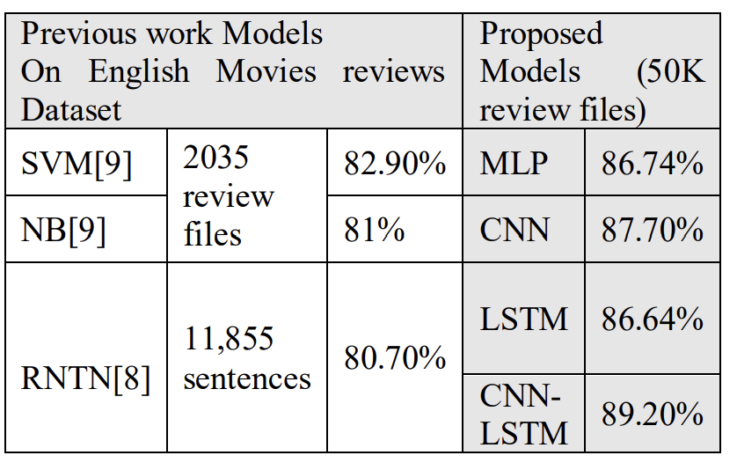
MAIN REFERENCE USED
Ali, Nehal & Hamid, Marwa & Youssif, Aliaa. (2019). SENTIMENT ANALYSIS FOR MOVIES REVIEWS DATASET USING DEEP LEARNING MODELS. International Journal of Data Mining & Knowledge Management Process. 09. 19-27. 10.5121/ijdkp.2019.9302.
In this reference paper, the authors majorly focused on implementing Word2Vec embeddings from keras and the used models like MLP, CNN , CNN-LSTM. They have achieved best accuracy with CNN-LSTM model.

Slide 7
DIFFERENCE IN APPROACH
Three main differences are :
In the reference paper they have used only Word2Vec, we have tried both Word2Vec and Glove Embeddings
The models they used are CNN,MLP, CNN_LSTM. Whereas we have implemented LSTM, BILSTM , and CNNLSTM.
References included Word2Vec embeddings provided by Keras library, we have used Word2Vec embeddings from Gensim library with vector size 300.

Slide 8
DIFFERENCE IN ACCURACY
Accuracy in the Reference paper
Accuracy we got with Word2Vec
Accuracy we got with GloVe
MODEL | ACCURACY
LSTM | 89.200%
BIDIRECTIONAL LSTM | 90.32%
CNN_LSTM | 89.039%
MODEL | ACCURACY
LSTM | 89.039%
BIDIRECTIONAL LSTM | 88.444%
CNN_LSTM | 88.424%

Slide 9
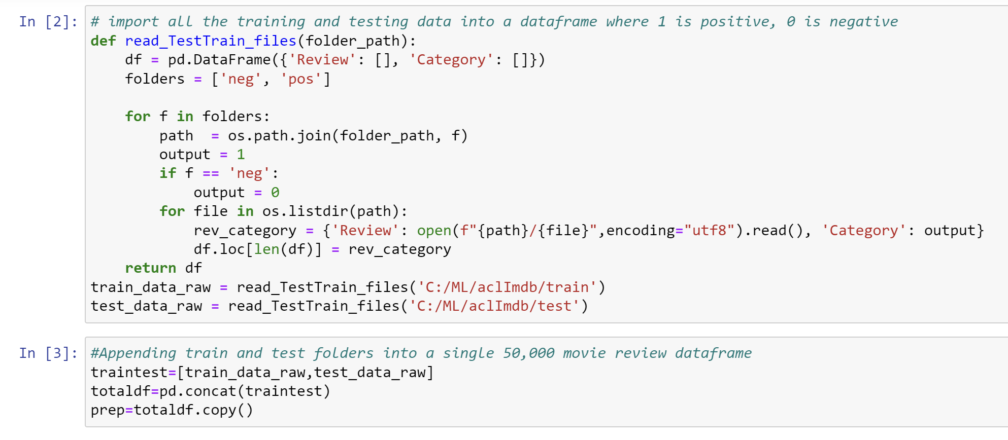
LOADING THE DATASET
IMPLEMENTATION
The total size of the dataset is 50,000 reviews where it was split into 25,000 reviews for the train set, and 25,000 reviews for the test set. So, we have appended the train and test folders into a single data frame.

Slide 10
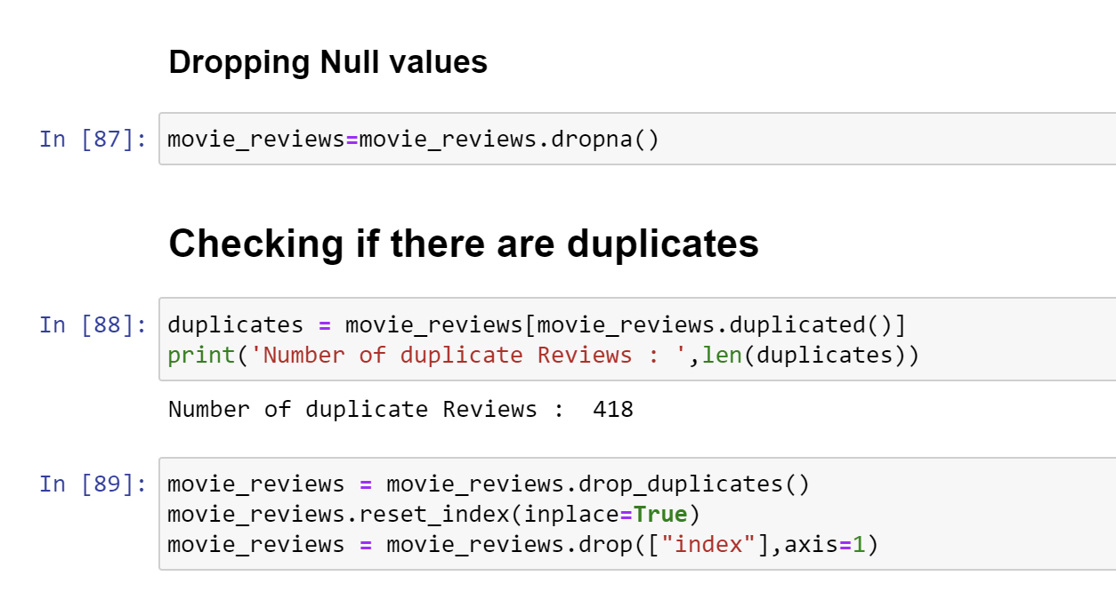
Data cleaning : HANDLING NULL AND DUPLICATE DATA
Checking whether the dataset have null and duplicate values and remove them :

Slide 11
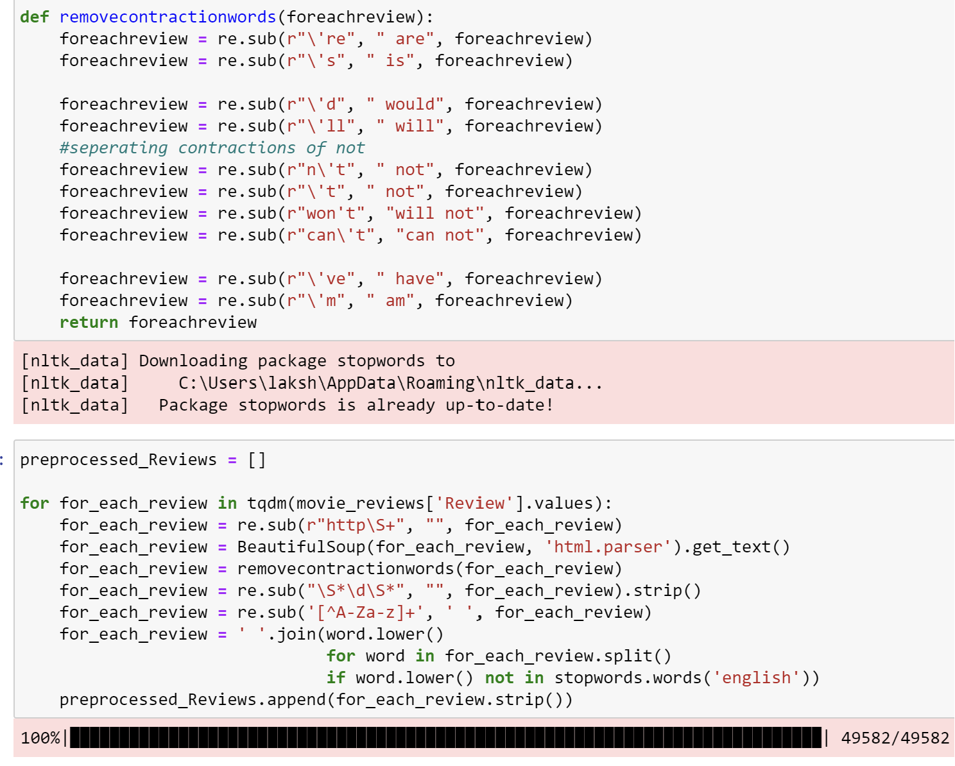
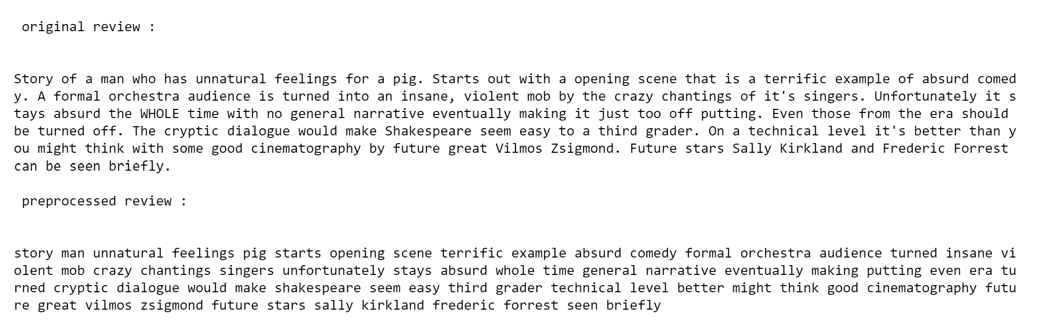
preprocessing
Remove contraction words and expanding them, Also using regular expressions for string manipulations like special character , digits removal, html tags removal , and html parsing, also lowercasing and removing stopwords.

Slide 12
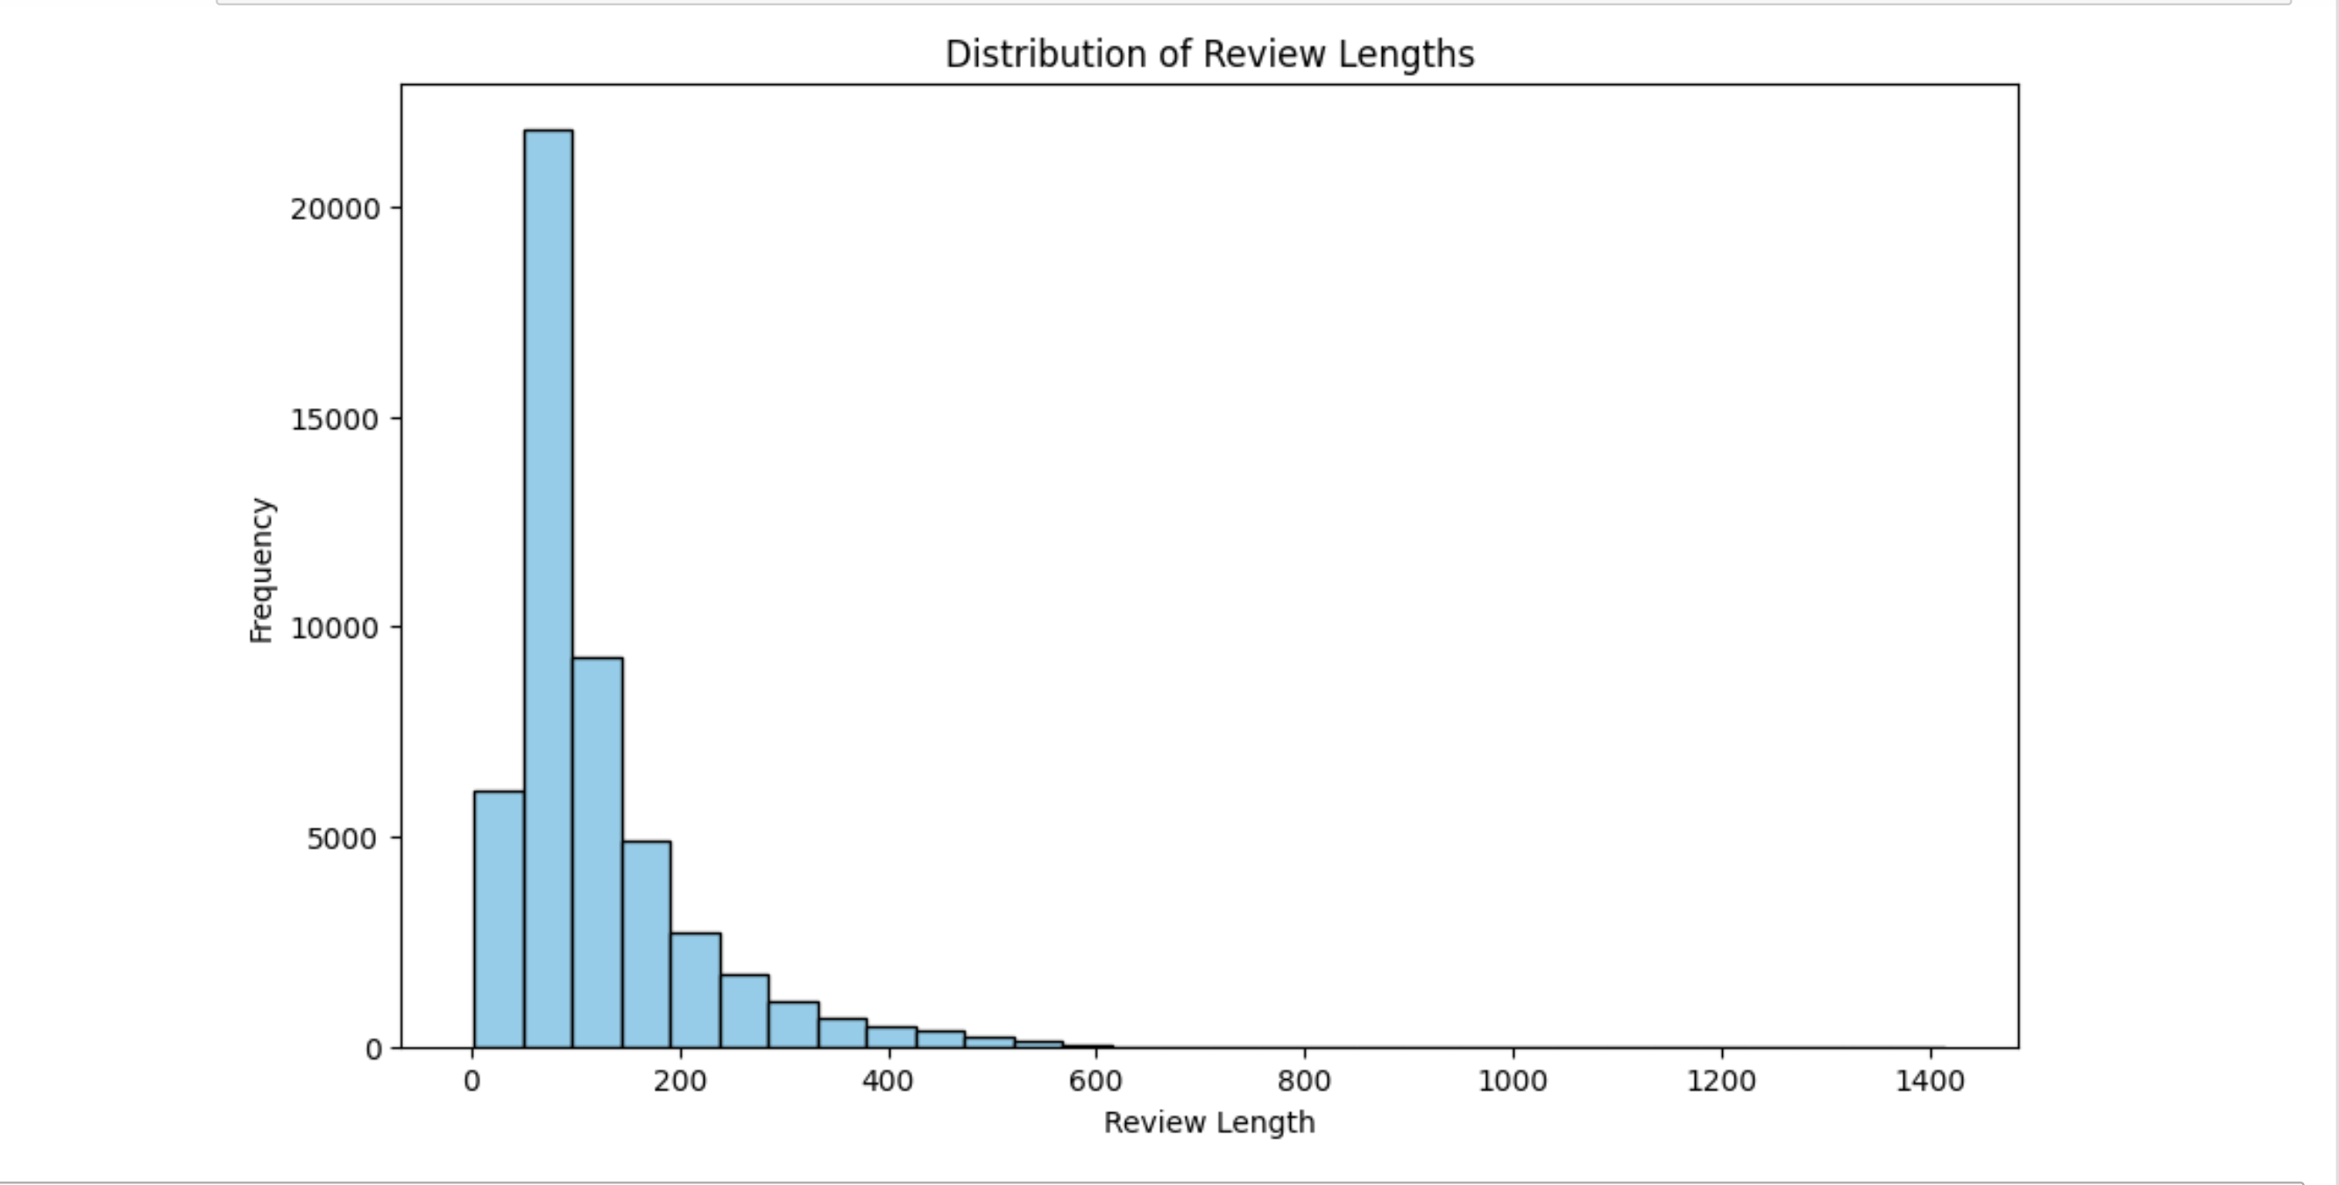
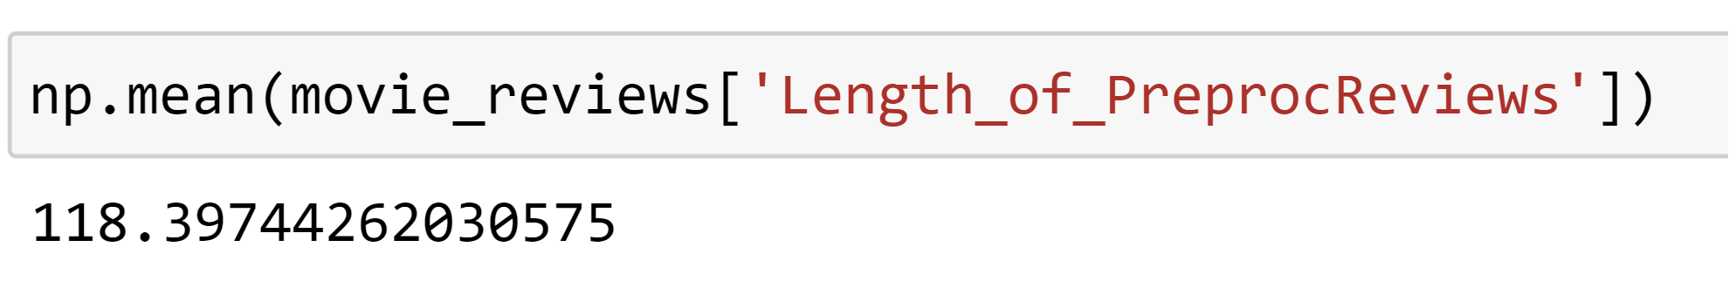
Setting the max length for reviews
After saving the preprocessed dataset, added a column of preprocessed movie length this lets us Check the distribution of the review lengths to get an idea for setting max input length for a review.
So, the mean of reviews is around 120, so value below that has not be taken because information will be lost. We tried experimenting various lengths and set value to 250.

Slide 13
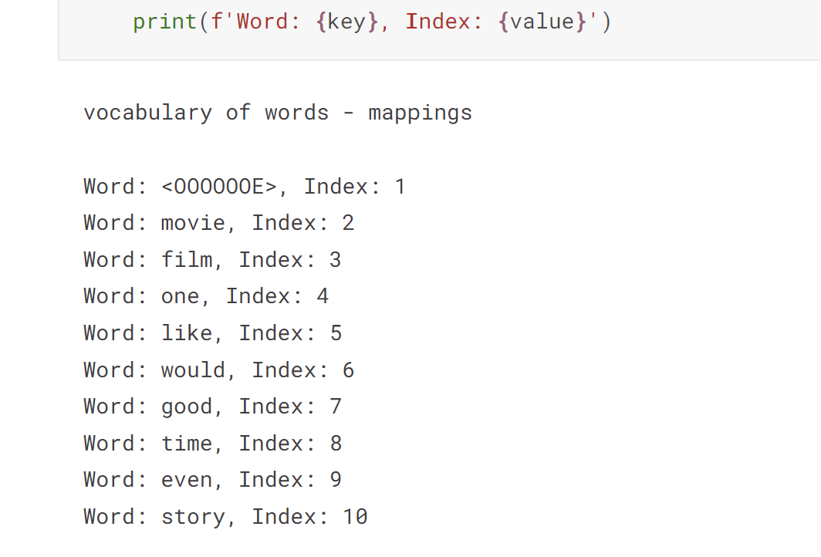
Building vocabulary
After splitting into train and test, With the help of Tokenizer class from Keras, we build the vocabulary of distinct words from all the movie reviews and set the special token for words out of the vocabulary.

Slide 14
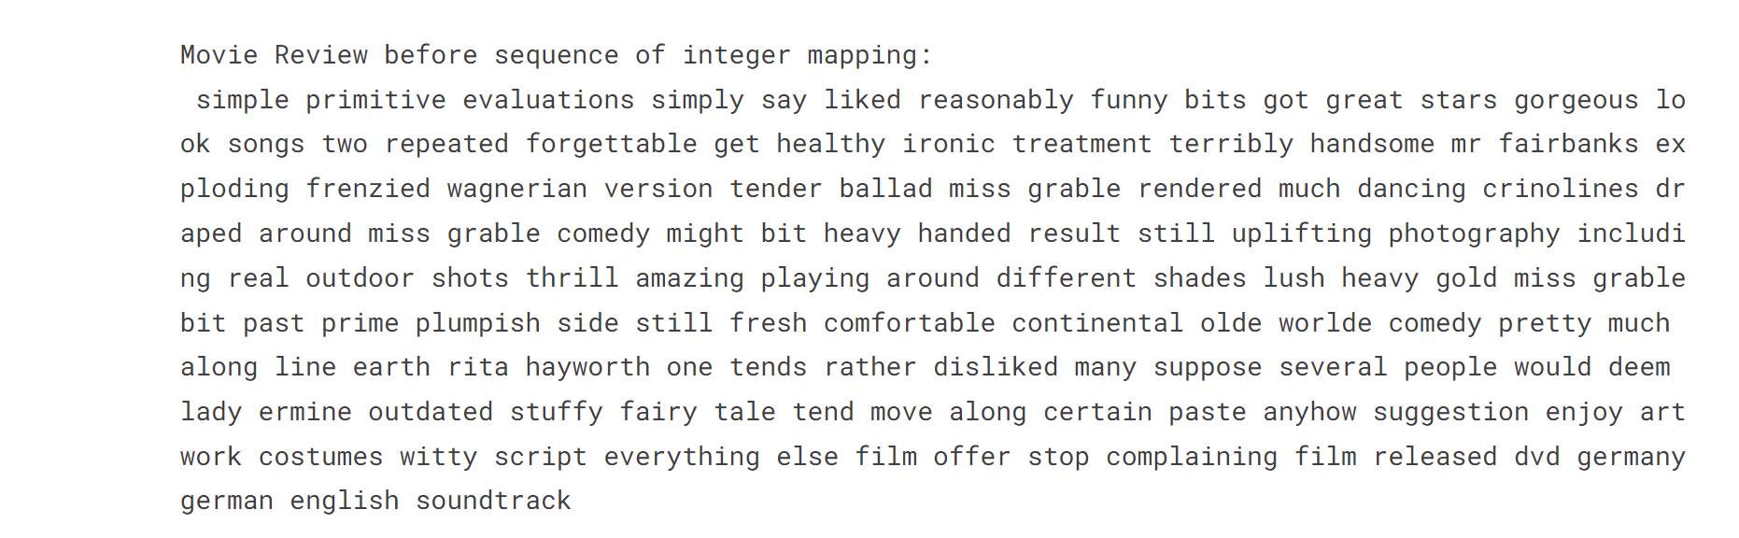
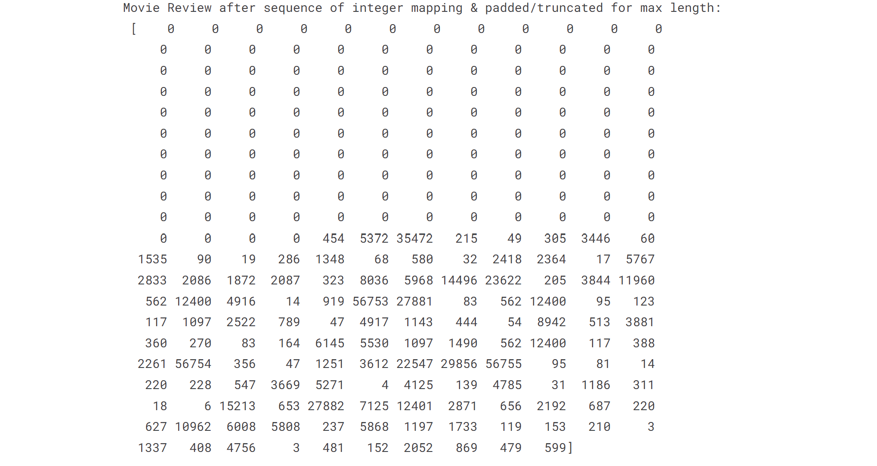
MAPPING REVIEWS TO SEQUENCE OF INTEGERS
A movie review before mapping to sequence of integers.
A movie review after mapping by text_to_sequence and padded as max length of review is set to 250

Slide 15
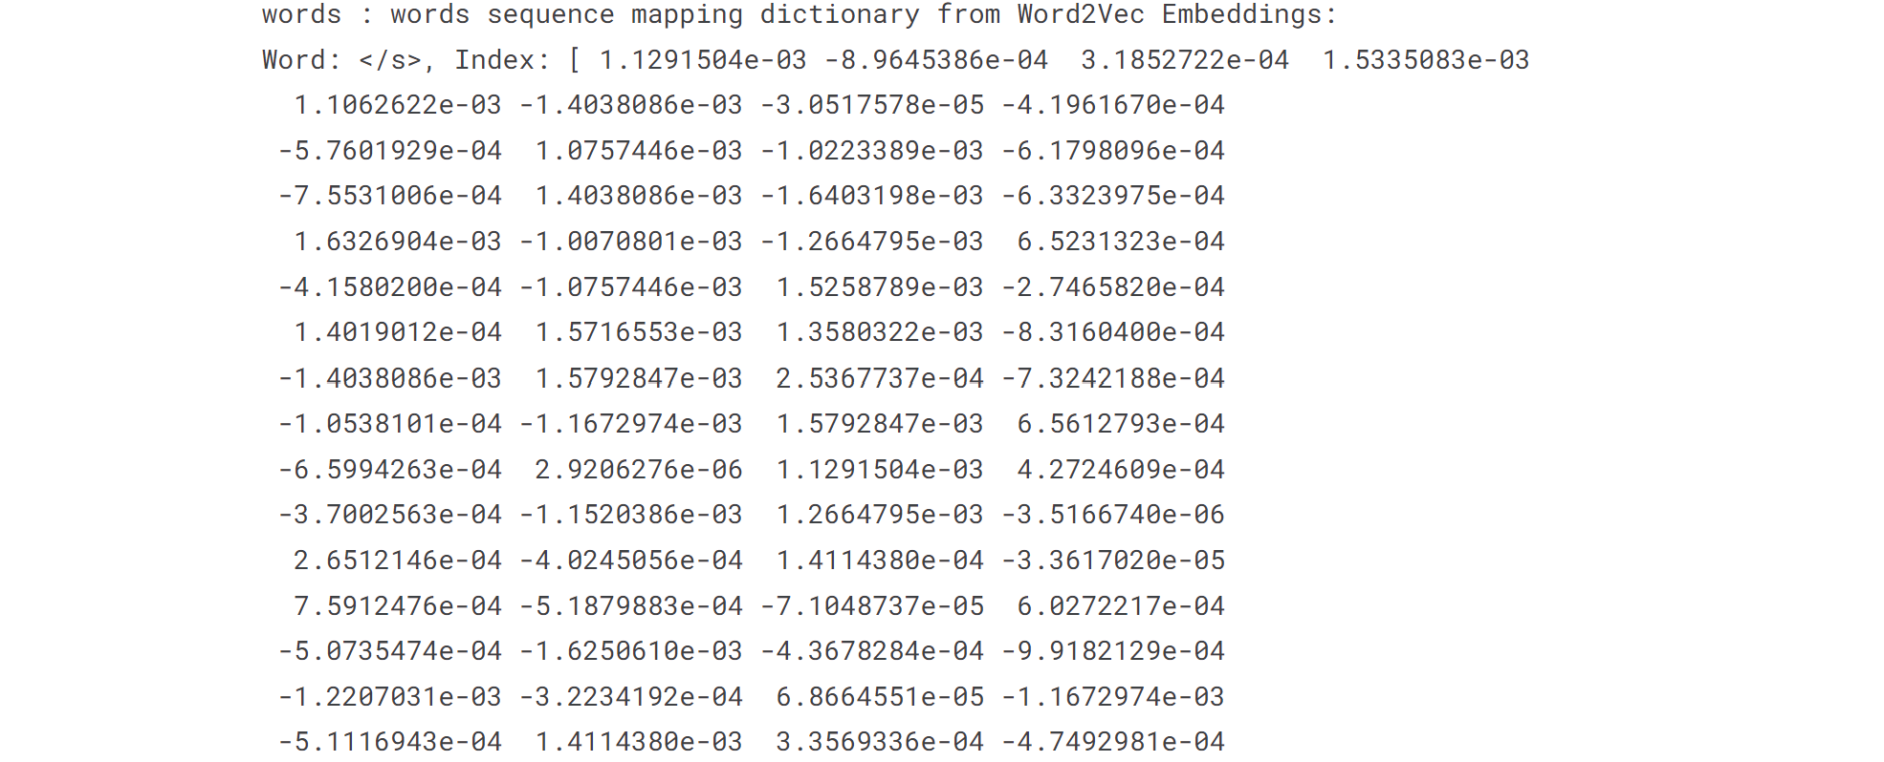
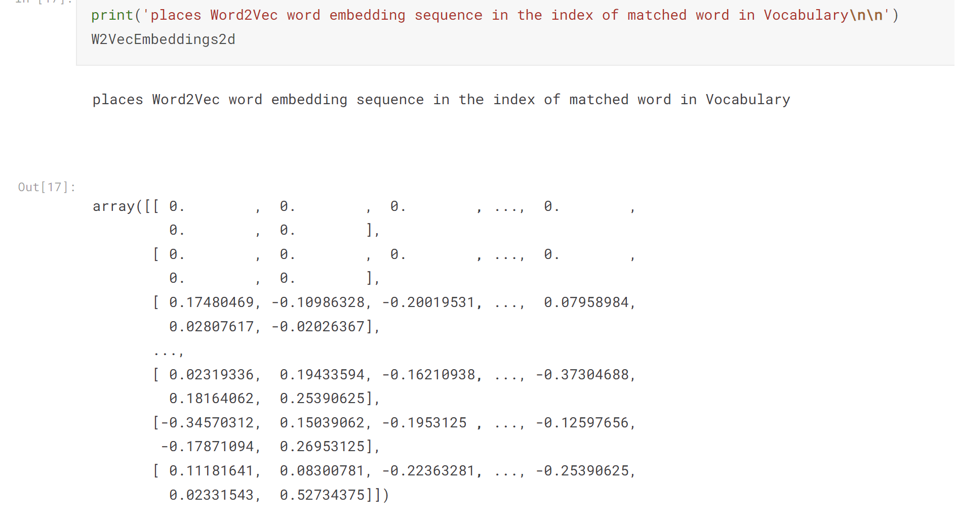
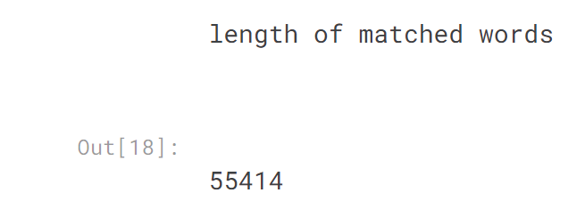
USING PRE-TRAINED WORD EMBEDDINGS- “WORD2VEC”
These are the words in Word2Vec, and representation of words in vectors.
The words in our vocabulary are replaced with the word vectors of Word2Vec Embeddings if they are matched. Not matched words are placed with zeroes.
The total of matched words with Word2Vec are 55414

Slide 16
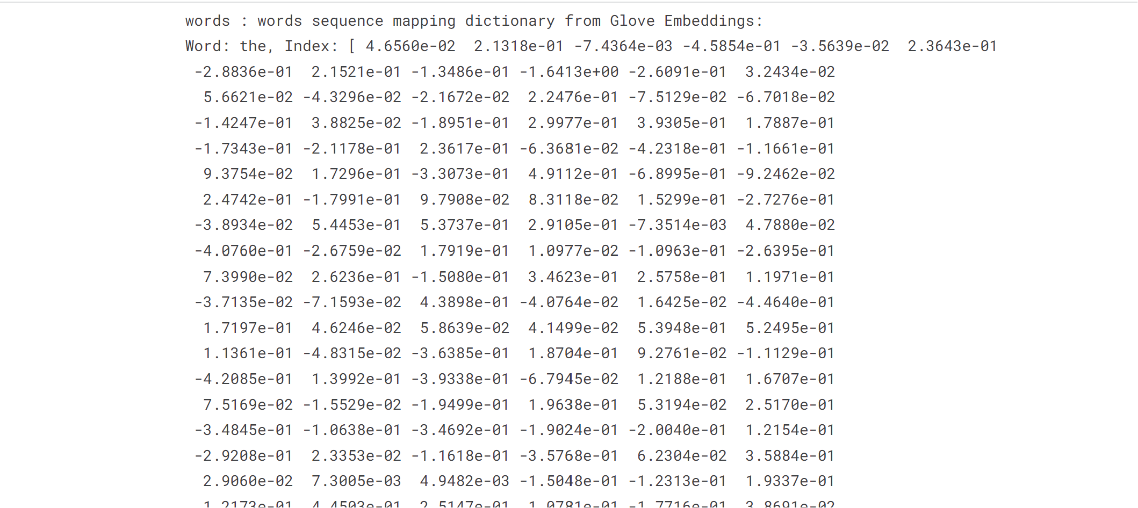
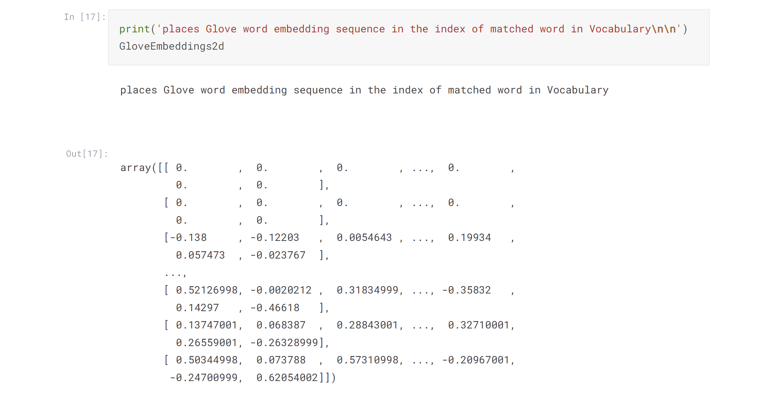
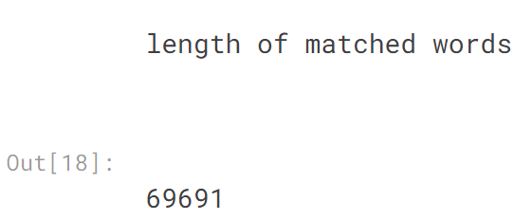
USING PRE-TRAINED WORD EMBEDDINGS- “GLOVE”
These are the words in Glove, and representation of words in vectors.
The words in our vocabulary are replaced with the word vectors of Glove Embeddings if they are matched.Not matched words are placed with zeroes.
The total of matched words with Word2Vec are 69691 .

Slide 17
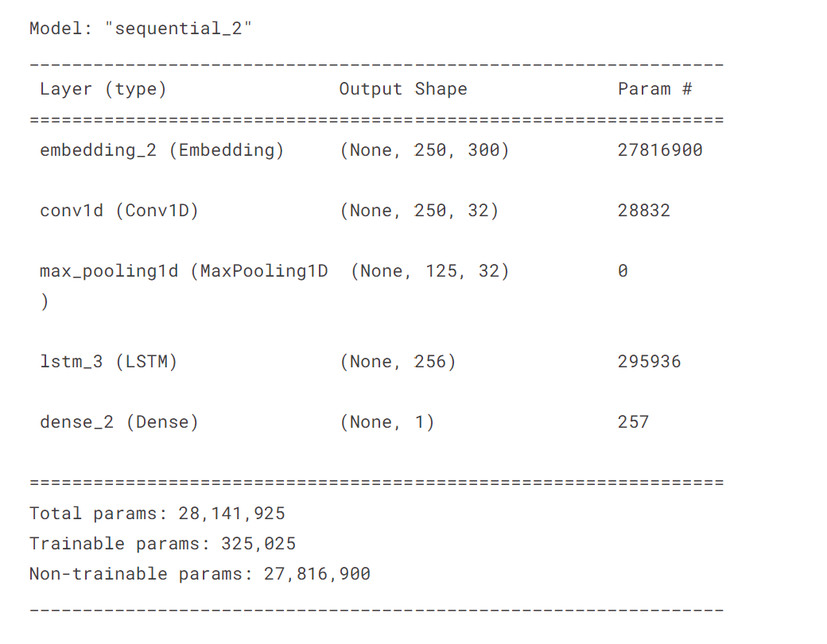
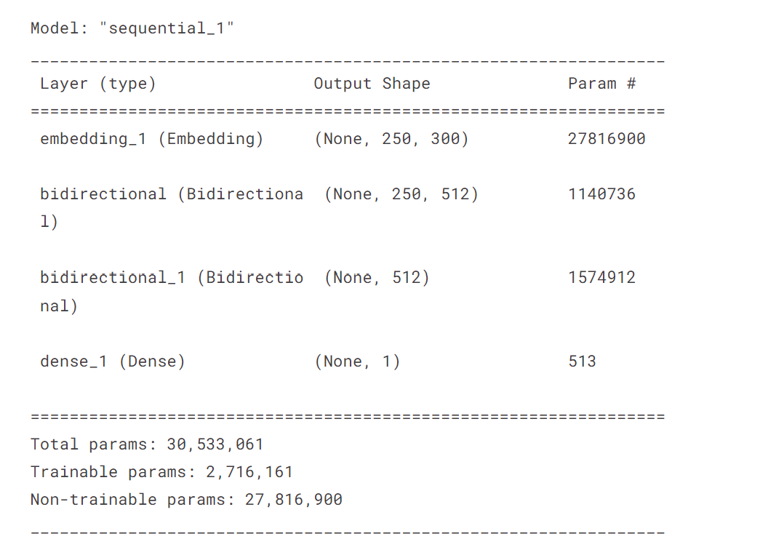
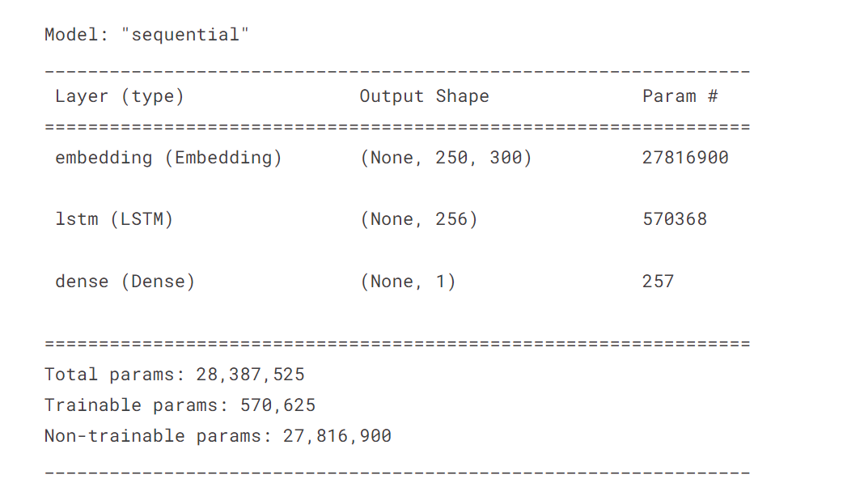
BUILDING MODELS : LSTM, BIDIRECTIONAL LSTM, CNNLSTM
LSTM
Here the LSTM model we used contains three layers: embedding layer, which takes weights from either Word2Vec, or Glove . LSTM layer and a single Dense layer with sigmoid activation for output.
BI-DIRECTIONAL LSTM
Here the BI-LSTM model we used contains four layers: embedding layer, which takes weights from either Word2Vec, or Glove . 2 Biderctional LSTM layers and a single Dense layer with sigmoid activation for output.
CNN_LSTM
Here the CNN-LSTM model we used contains five layers: embedding layer, which takes weights from either Word2Vec, or Glove . CNN and MaxPooling layers, LSTM layer, and a single Dense layer with sigmoid activation for output.

Slide 18
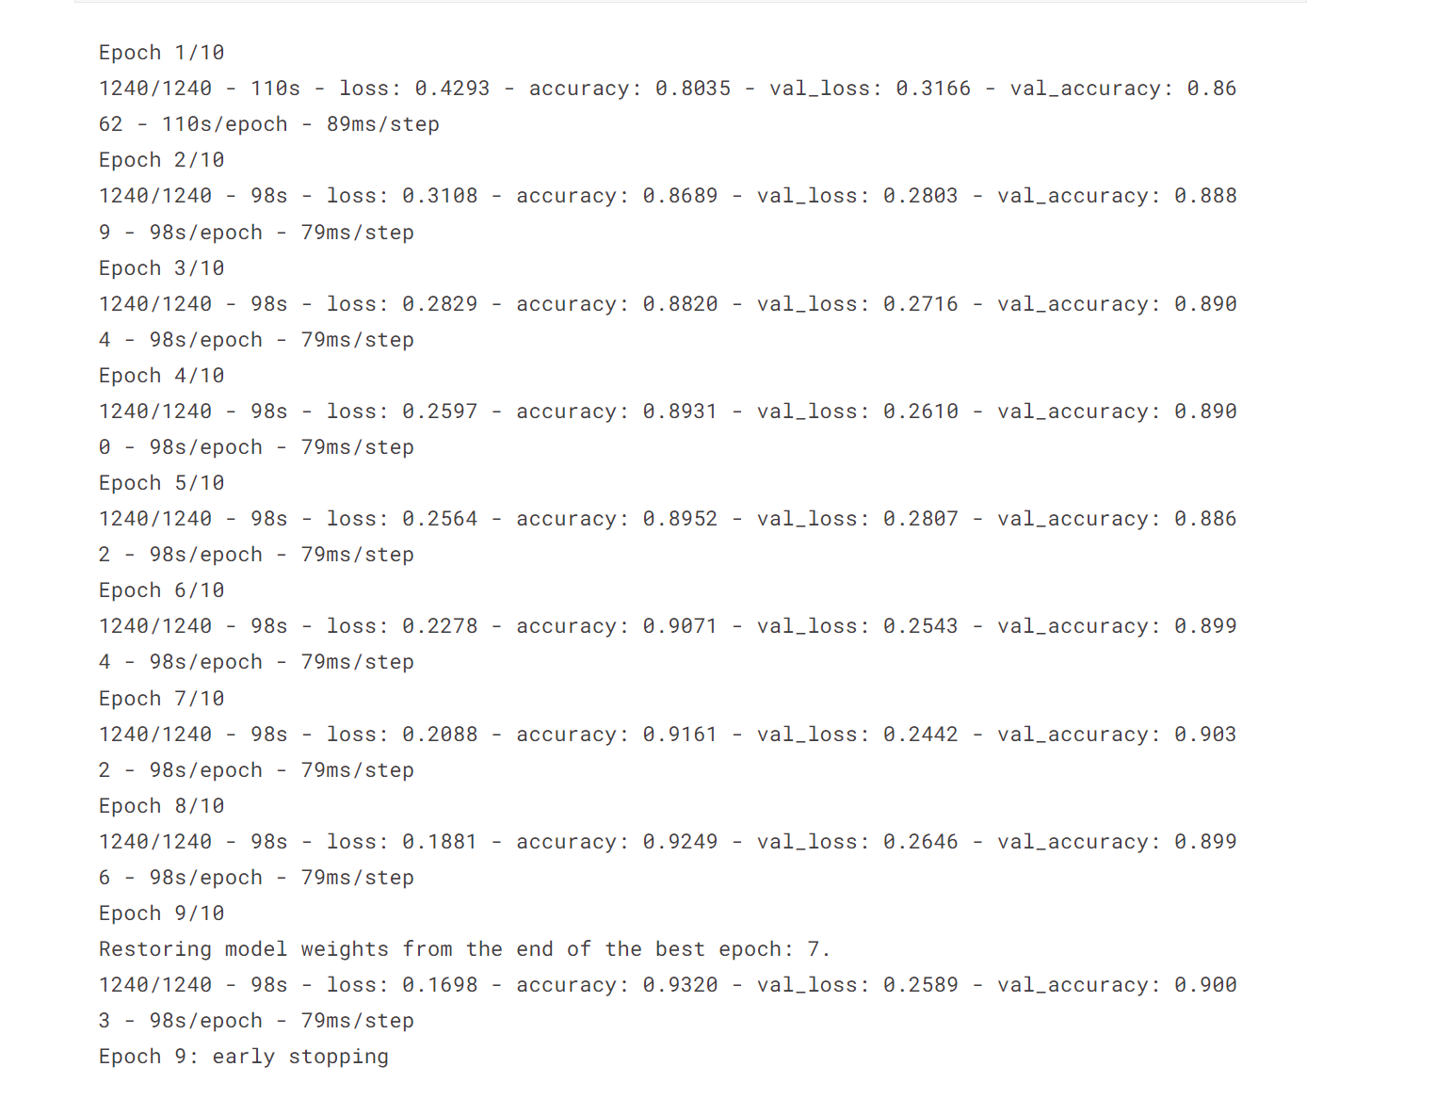
TRAINING

Slide 19
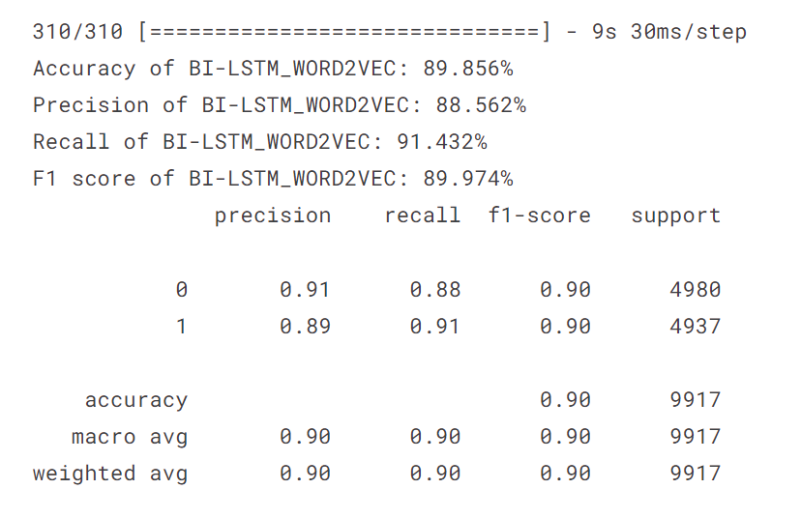
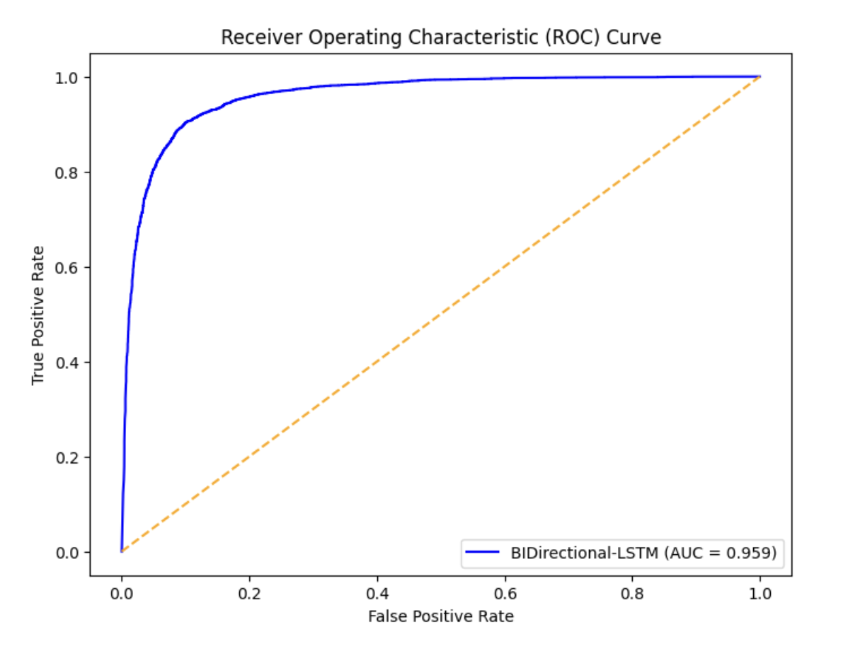
6. RESULTS
WORD2VEC EMBEDDING
MODEL | ACCURACY
LSTM | 89.200%
BIDIRECTIONAL LSTM | 89.850%
CNN_LSTM | 89.039%
For all these models , binary cross entropy is taken as loss, optimizer is adam, and no of epochs taken are 47.
So, from the results the best performed model with Word2Vec Embeddings is BiDirectional LSTM with accuracy 89.86%
ROC curve with AUC:
AUC=0.959
BIDIRECTIONAL_LSTM - WORD2VEC

Slide 20
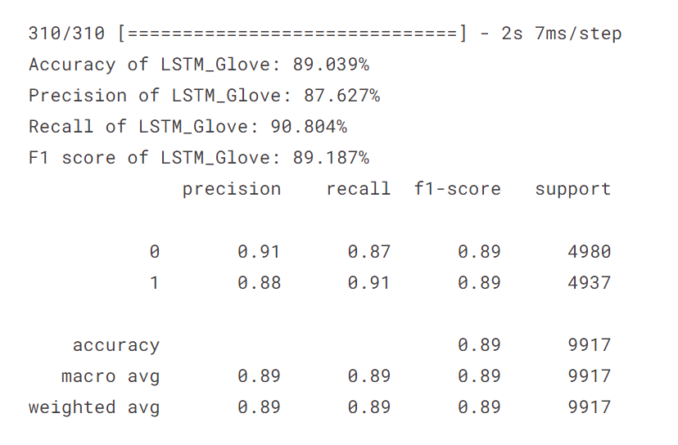
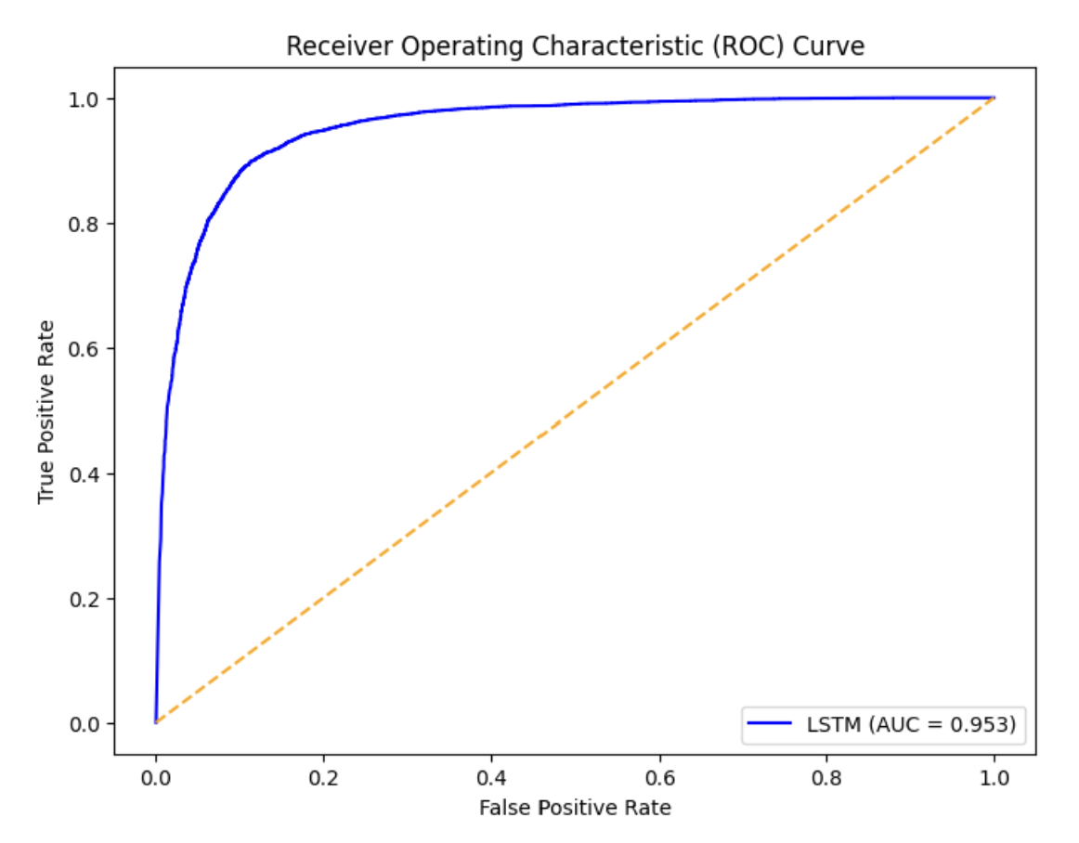
6. RESULTS
GLOVE EMBEDDING
MODEL | ACCURACY
LSTM | 89.039%
BIDIRECTIONAL LSTM | 88.444%
CNN_LSTM | 88.424%
For all these models , binary cross entropy is taken as loss, optimizer is adam, and no of epochs taken are 47.
So, from the results the best performed model with GLOVE Embeddings is LSTM with accuracy 89%
ROC curve with AUC:
AUC=0.953
With LSTM - GLOVE EMBEDDING

Slide 21
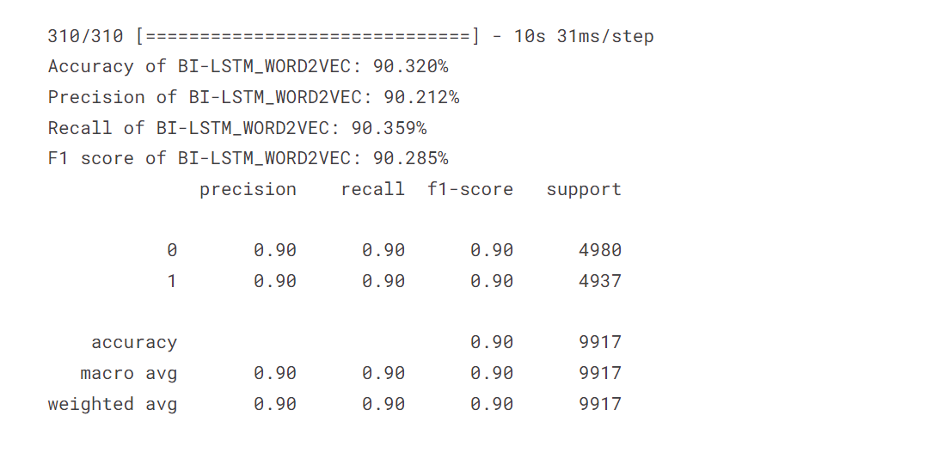
TUNING TO IMPROVE ACCURACY
So from various comparisions we found that BILSTM model combined with Word2Vec weights is perfoming better. So doing hyperparameter tuning to see if the accuracy improves.
After tuning the dataset multiple times we have found the best parameters like lstm units =256, dropofLSTM=0.3, and learning rate =0.001 and accuracy improved to 90.320%.

Slide 22
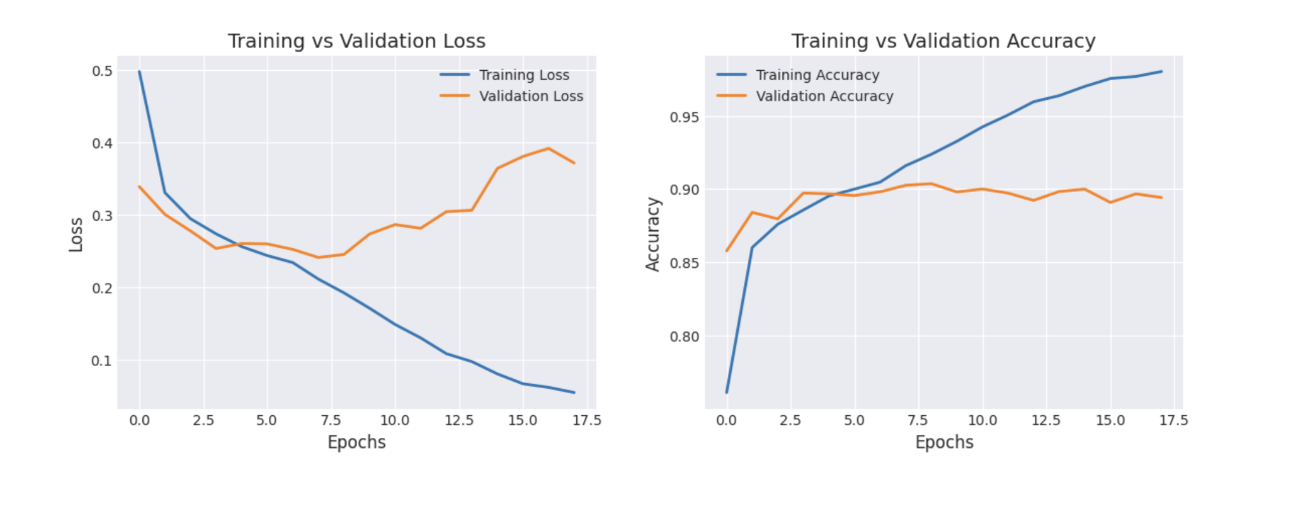
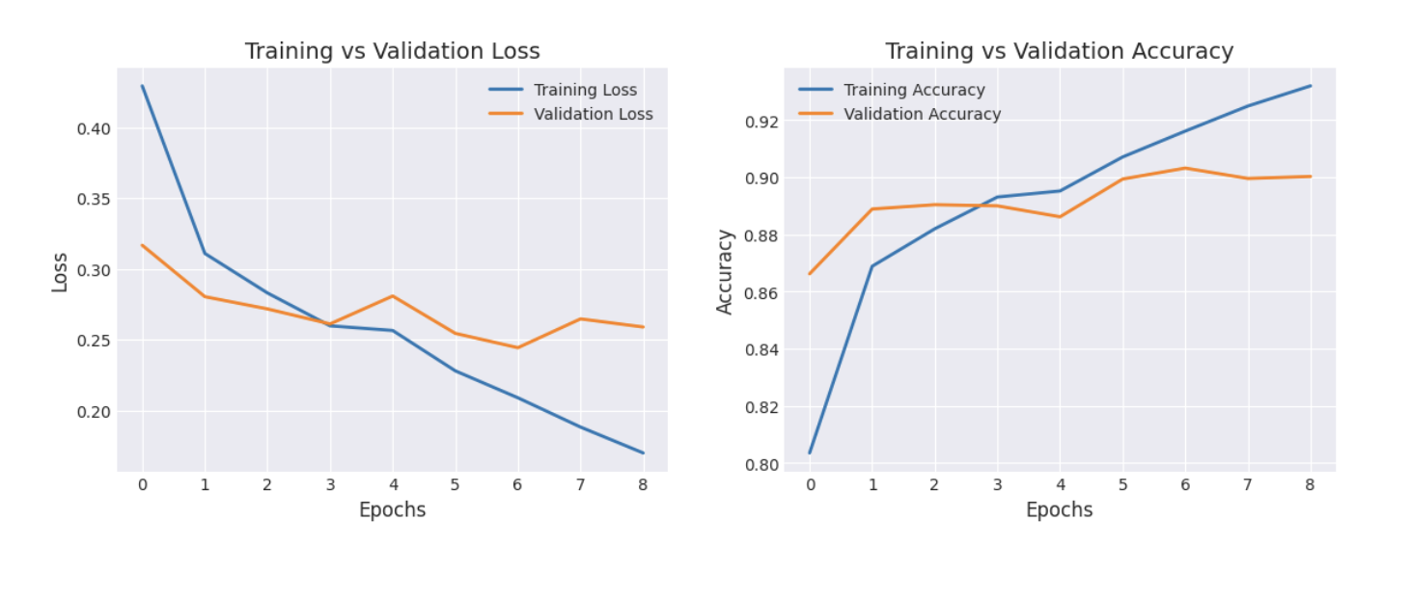
ANALYSIS
Initially We have run 40 epochs and from analysis the validation loss is getting increased after 8 epochs
So we have reduced the epochs to 10, this generalizes the test data well without the validation loss.

Slide 23
ENHANCEMENTS
We have implemented BiDirectional LSTM, with Word2Vec Embeddings which we achieved a accuracy of 90.32%.
Taken the Word2Vec embeddings from genism library , where the size of the vector embedding is 300.
Implemented two bidirectional layers , whereas references used the Hybrid CNNLSTM layers.

Slide 24
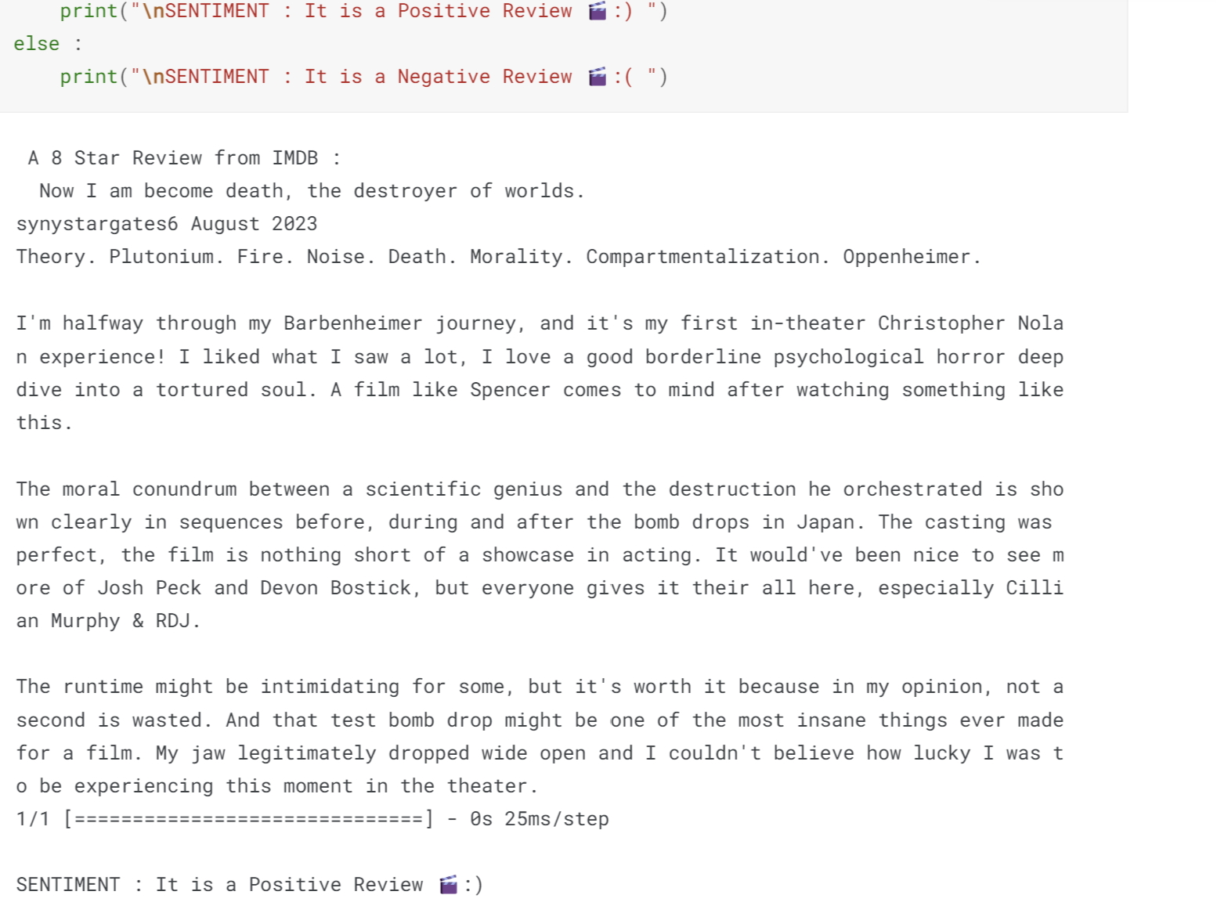
EVALUATION OF MODEL
Evaluating the model on a 8 star movie review(2023 movie) taken from IMDB to see whether it classifies it as a positive sentiment or a negative sentiment.
Classifies correctly as Positive review

Slide 25
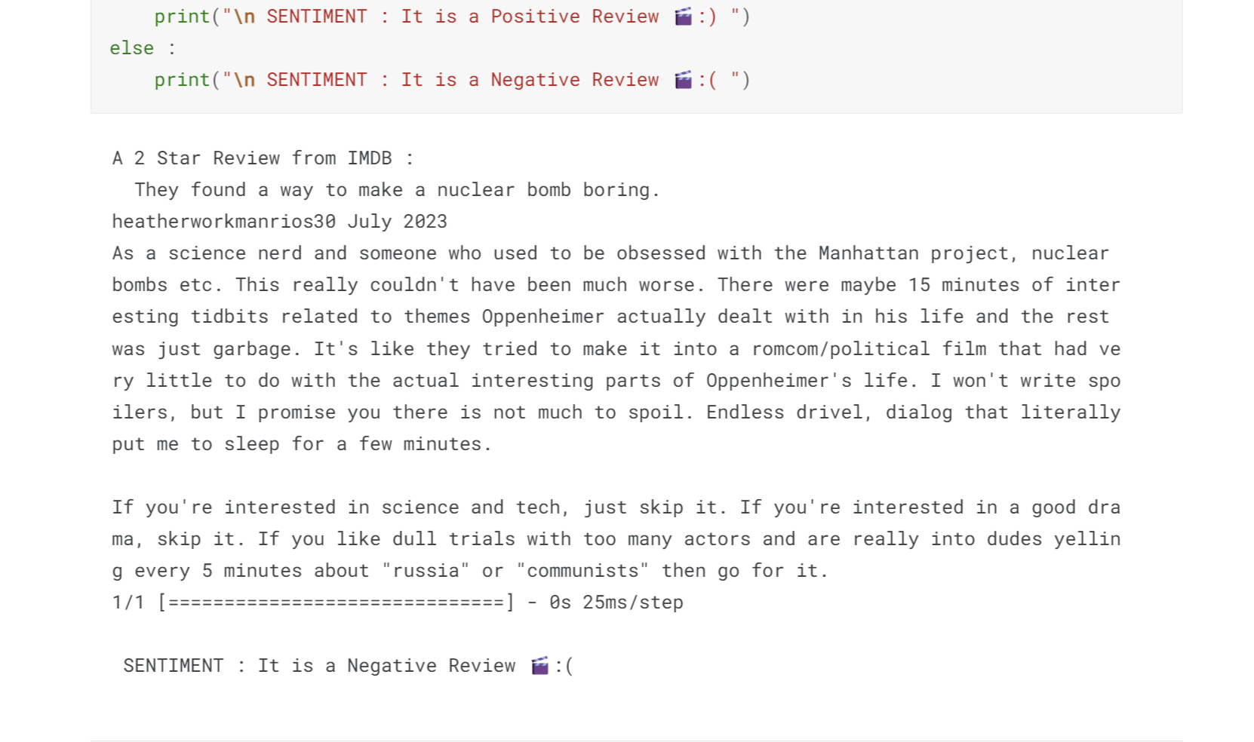
EVALUATION OF MODEL
Evaluating the model on a 2 star movie review(2023 movie) taken from IMDB to see whether it classifies it as a positive sentiment or a negative sentiment.
Classifies correctly as Negative review

Slide 26
REFERENCES:
Ali, Nehal & Hamid, Marwa & Youssif, Aliaa. (2019). SENTIMENT ANALYSIS FOR MOVIES REVIEWS DATASET USING DEEP LEARNING MODELS. International Journal of Data Mining & Knowledge Management Process. 09. 19-27. 10.5121/ijdkp.2019.9302. (PDF) SENTIMENT ANALYSIS FOR MOVIES REVIEWS DATASET USING DEEP LEARNING MODELS (researchgate.net)
Y. E. Rizk and W. M. Asal, "Sentiment Analysis using Machine Learning and Deep Learning Models on Movies Reviews," 2021 3rd Novel Intelligent and Leading Emerging Sciences Conference (NILES), Giza, Egypt, 2021, pp. 129-132, doi: 10.1109/NILES53778.2021.9600548. Sentiment Analysis using Machine Learning and Deep Learning Models on Movies Reviews | IEEE Conference Publication | IEEE Xplore
Tarimer, İlhan & Çoban, Adil & Kocaman, Arif. (2019). Sentiment Analysis on IMDB Movie Comments and Twitter Data by Machine Learning and Vector Space Techniques. https://www.researchgate.net/publication/332070477_Sentiment_Analysis_on_IMDB_Movie_Comments_and_Twitter_Data_by_Machine_Learning_and_Vector_Space_Techniques

Slide 27
THANK YOU

